Slide 1
[ 코드 분석 ] Web-based processing of 3D geometries

Slide 2

WebHF.js
WebHF
camera : null
controls : null
lights : { ambient: [], camera: [], directional: [] }
renderer:null
- init() : void /*Intialize everything: Camera, scene, renderer …*/
_initCamera() : void /* Intialize the camera */
_initControls() : void /* Initialize the controls */
_initLights() : void /* Initialize lights. Scene has to be initialized first. */
_initRenderer( container ) : void /* Initialize the renderer. */
animate() : void /* Start animation. */
loadChosenAdvancingFrontFile() : void /* Load the JavaScript file for the chosen Advancing Front implementation. */
render() : void /* Render */
resize() : void /* Adjust camera and renderer to new window size. */

Slide 3
SceneManager.js
WebHF.SceneManager
fillings: []
holeLines: []
holes: []
lightStatus: { ambient: true, camera: true, directional: true}
modeFilling: CONFIG.MODE
model: null
modeModel: CONFIG.MODE
scene: null
shading: CONFIG.SHADING
addAxis() : void /* Adds an axis to the scene. Does not call render() function! */
centerModel(mesh) : mesh /* position move to Center of a mesh.*/
@return {mesh} mesh moved to center
changeMode( ev, what ) : void /* Change the mode the model is rendered: Solid or Wireframe. */
@param {Event} ev
@param {string} what - "model" or "filling".
changeShading( ev ) : void /* Change the shading of the material: Flat or Phong. */
clearModels() : void /* Clear the scene (except for the lights, camera and axis). */
createCrossVector( vp, v, vn, size, color, moveWithModel ) : point, line /* Create an optical representation of a cross vector. */
@param {THREE.Vector3} vp - Previous vector.
@param {THREE.Vector3} v - Center vector of the angle.
@param {THREE.Vector3} vn - Next vector.
@param {number} size - Size of the point.
@param {(number|string)} color - Color for the objects.
@param {boolean} moveWithModel - Adjust position with the currently loaded model.
@return {object} Point and line for the cross vector.
createLine( start, end, width, color, moveWithModel ) : line /* Create a line from a starting to an end point. */
@param {THREE.Vector3} start - Start point.
@param {THREE.Vector3} end - End point.
@param {number} width - Line width of the line.
@param {(number|string)} color - Color of the line.
@param {boolean} moveWithModel - If true, move the line to the position of the model.
@return {THREE.Line} A THREE.Line object.

Slide 4
SceneManager.js
WebHF.SceneManager
createPoint( position, size, color, moveWithModel ) : mesh /* Create a sphere mesh. */
@param {object} position - Position of the sphere.
@param {number} size - Radius of the sphere.
@param {(number|string)} color - Color of the sphere.
@param {boolean} moveWithModel - If true, move the point to the position of the model.
@return {THREE.Mesh}
exportModel( format, modelName ) : mesh /* Export the model. */
@param {string} format - Name of the format to use.
@param {?string} modelName - Name for the model.
@return {string} Exported model data.
fillHole( ev ) : void /* Start the hole filling. */
@param {Event} ev
findHoles( ) : void /* Show the border edges of the model. */
@param {Event} ev
fitCameraToModel( ) : void /* Fit the camera position to the model size. */
focusHole( index ) : void /* Focus on the found hole. */
@param {number} index - Index of the found hole
geometryToMesh( geometry ) : mesh /* Prepare the model as mesh. */
@param {THREE.Geometry} geometry - Geometry of the model.
@return {THREE.Mesh} Model as mesh.
isFlatShading() : Boolean /* Get the current shading type. */
Init() : void /* Initialize the scene. */
mergeWithFilling( filling, holeIndex ) : void /* Merge the model with the new filling. */
@param {THREE.Geometry} filling - The filling to merge into the model.
@param {number} holeIndex
moveCameraLights( ev ) /* Move the camera lights to the camera position. */
@param {Event} ev - Change event fired by THREE.TrackballControls
moveCameraToPosition( stepX, stepY, stepZ, count ) /* Move the camera (more-or-less) fluently to a position. */
@param {number} stepX - Step length in X direction.
@param {number} stepY - Step length in Y direction.
@param {number} stepZ - Step length in Z direction.
@param {number} count - Counter to know when to stop.
renderBoundingBox( model ) /* Show the bounding box of the model. */
@param {THREE.Mesh} model - The model.

Slide 5
SceneManager.js
WebHF.SceneManager
resetCamera() : void /* Reset the camera settings. */
showFilling( front, filling, holeIndex ) : void /* Render the finished hole filling. Create a mesh from the computed data and render it. */
@param {THREE.Geometry} front - Front of the hole.
@param {THREE.Geometry} filling - Filling of the hole.
@param {number} holeIndex@return {THREE.Mesh}
toggleLight( ev ) : void /* Switch the light on or off. */
@param {Event} ev

Slide 6
config.js
WebHF.Config
ALLOWED_FILE_EXTENSIONS: ['obj', 'ply', 'stl', 'vtk'],
AXIS: SHOW: true, SIZE: 60,
BBOX: COLOR: 0x37FEFE, SHOW: false,
CAMERA: ANGLE: 45, FOCUS(DISTANCE_FACTOR: 1.8, STEPS: 0, TIMEOUTS: 30), ZFAR: 2500, ZNEAR: 0.01,
CHECK_AND_FIX_FACES: true,
CONTROLS: PAN_SPEED: 0.8, ROT_SPEED: 1.5, ZOOM_SPEED: 2.0,
DEBUG: AF_INVALIDATE_CACHE: true, AF_STOP_AFTER_ITER: 2000, ENABLE_STOPWATCH: true, SHOW_FRONT: false, SHOW_MERGING: false,
EXPORT: DEFAULT_FORMAT: 'STL', FORMATS: ['OBJ', 'STL'],
// AF_MODE values: "iterative", "responsive", "parallel"
// COLLISION_TEST values: "filling" or "all"
// Threshold for correcting the position of a new vertex, judging by the variance of close vertices. Helps flatten the filling.
// Number of Web Worker threads (only working in 'parallel mode'
FILLING:
AF_MODE: 'iterative', COLLISION_TEST: "filling", COLOR: 0x87C3EC, LINE_WIDTH: 2, PROGRESS_UPDATE: 4, SHOW_WIREFRAME: false,
THRESHOLD_VARIANCE: 0.05, WORKER: 4
// Outline of the hole(s)
HOLES: COLOR: [0xFF0000, 0xE227BD, 0xFFA420, 0x38F221], LINE_WIDTH: 3, SHOW_LINES: true, SHOW_POINTS: false,
LIGHTS: AMBIENT: [{ color: 0x101016 }], CAMERA: [{color: 0xFFFFFF, intensity: 0.8}], DIRECTIONAL: [{color: 0xFFFFFF,intensity: 0.3,position: [1, 0, 1]}],
// Mode: "solid", "wireframe"
MODE: 'solid',
// Options that will be passed to the THREE.WebGLRenderer as is
RENDERER: alpha: true, antialias: true, maxLights: 4,
// Shading: "flat" or "phong"
SHADING: 'flat'

Slide 7
Utils.js
WebHF.Utils
calculateAngle(vp, v, vn, move) : number /* Calculate the angle between two vertices. Angle is in degree. */
@param {THREE.Vector3} vp - The previous vertex.
@param {THREE.Vector3} v - The current vertex.
@param {THREE.Vector3} vn - The next vertex.
@param {?THREE.Vector3} move - Move by this vector.
@return {number} Angle between the vertices in degree and flag if it has been adjusted to point into the hole.
calculateAngleAverage( gv, modelPos ) : number /* Calculate the average of all angles in a given list of vertices. */
@param {THREE.Vector3[]} gv - List of vertices.
@param {THREE.Vector3} modelPos - Position of model the vertices are a part of.
@return {number} The angle average.
calculateVariances(vectors) : object/* Calculate standard variance and average of the X, Y and Z coordinates of the given vectors. */
@param {THREE.Vector3[]} vectors - The vectors to use.
@return {object} Object of the X, Y and Z variances and averages.
checkIntersectionOfLines2D( p1, p2, q1, q2 ):Boolean /* Check if two lines intersect */
@param {THREE.Vector2} p1
@param {THREE.Vector2} p2
@param {THREE.Vector2} q1
@param {THREE.Vector2} q2
@return {boolean} True, if lines intersect, false otherwise.
checkIntersectionOfTriangles2D( a, b, c, fromA, fromB, v ):Boolean /* Check if lines of two triangles intersect. */
@param {THREE.Vector2} a
@param {THREE.Vector2} b
@param {THREE.Vector2} c
@param {THREE.Vector2} fromA
@param {THREE.Vector2} fromB
@param {THREE.Vector2} v
@return {boolean} True, if lines intersect, false otherwise.

Slide 8
Utils.js
WebHF.Utils
checkIntersectionOfTriangles3D( a, b, c, p, fromA, fromB ) : Boolean/* Check if lines of one triangle intersects with surface of another. */
@param {THREE.Vector3} a
@param {THREE.Vector3} b
@param {THREE.Vector3} c
@param {THREE.Vector3} p
@param {THREE.Vector3} fromA
@param {THREE.Vector3} fromB
@return {boolean} True, if triangles intersect, false otherwise.
decreaseHigherFaceIndexes( faces, i, cmpIndex ) : Face array /* Decrease the face index of vertices that have a higher index than a given one. Afterwards check the face and if faulty, remove it.*/
@param {THREE.Face3[]} faces - Faces to change.
@param {number} i - Current index of face to check.
@param {number} cmpIndex - Threshold index to compare to.
@return {THREE.Face3[]} Changed faces.
floatToScientific( value ) : string/* Convert the format of a float into a scientific notiation. */
@param {number} value - The value to convert.
@return {string} The scientific notation.
getAverageLength(vectors) : number /* Get the average length of a list of vectors. */
@param {THREE.Vector3[]} vectors - Array of vectors.
@return {number} Average length.
isPointInTriangle( p, a, b, c ) :Boolean /* Checks if a point lies in a triangle (2D). */
@param {THREE.Vector2} p - The point to check.
@param {THREE.Vector2} a - Point A describing the triangle.
@param {THREE.Vector2} b - Point B describing the triangle.
@param {THREE.Vector2} c - Point C describing the triangle.
@return {boolean} True, if point is inside triangle, false otherwise.

Slide 9
Utils.js
WebHF.Utils
isSameSide( p1, p2, a, b ): Boolean/* Check, if two points lie on the same side of a line (2D). */
@param {THREE.Vector2} p1
@param {THREE.Vector2} p2
@param {THREE.Vector2} a
@param {THREE.Vector2} b
@return {boolean} True, if on the same side, false otherwise.
keepNearPlane( vNew, vectors, mergeThreshold) : Vector3 /* Keep a vector close to the plane of its creating vectors. Calculates the standard variance of the X, Y, and Z coordinates and adjusts the coordinate of the new vector to the smallest one. */
@param {THREE.Vector3} v - One of the creating vectors.
@param {THREE.Vector3} vn - One of the creating vectors.
@param {THREE.Vector3} vNew - The newly created vector.
@return {THREE.Vector3} Adjusted vector.
selfRemoveFromDOM(ev) : void /* Remove child from its parent. */
@param {Event} ev

Slide 10
UI.js
WebHF.UI
callbackExport: null
callbackFillHole: null
domDetails: null
fillButton: null
visibleProgress: null
changeExportName( ev ):void /* Change the export filename according to the chosen file format. */
checkHoleFinished( index ):void /* Signal in the hole selection that a hole has already been filled.*/
@param {number} index - Index of the hole.
cleanOfChildNodes( node ) : HTMLElement /* Remove all child nodes of a node.*/
@param {HTMLElement} node
@return {HTMLElement} The given node after removing the child nodes.
disableFillButton() : void /* Disable the fill button. */
dragoverOfImport( ev ): void /* Dragover event of import area. */
hideAllDetails( ) : void /* Hide all details. */
init(): void /* Init everything related to UI. */
resetInterface():void /* Reset the interface. */
selectHole( ev ) : void /* Select a hole. Focus on it and show additional details. */
showDetailExport() : void /* Show further options for the export. */
showDetailHoles( foundHoles ) : void /* List the found holes. */
@param {THREE.Line[]} foundHoles - The found holes.
startExport( ev ) : void /* Trigger the export. */
syncInterfaceWithConfig() : void /* Set the user interface settings according to the settings in the config file (config.js). */
updateProgress: function( value ) : void /* Update the visible progress bar. */
@param {number} value - New progress value. Think of it in percent.

Slide 11
UI.js
WebHF.UI.BUILDER
createButton( value, clickCall, id ) : HTMLElement /* Create a button. */
@param {string} value - Value of the input.
@param {?function} clickCall - Function to call if input is clicked.
@param {?string} id - ID for the input element.
@return {HTMLElement} The created input button.
createProgress() : HTMLElement /* Create a progress bar element. */
@return {HTMLElement} Progress element.
createRadioPair( group, id, radioValue, btnText ) : object /* Create a pair of hidden radio element and button, that checks it. */
@param {string} group - Name of the radio group the pair belongs to.
@param {string} id - ID for the radio element.
@param {string} radioValue - Value for the radio element.
@param {string} btnText - Text for the button.
@return {object} Object with the radio element and the button.

Slide 12
UI.js
WebHF.UI.REGISTER
registerEvents() :void /* Add all the needed event listeners.*/
registerCameraReset() :void /* Listen to events of the camera reset button.*/
registerCollisionTestOptions() :void /* Listen to events of the collision test options.*/
registerEditOptions() :void /* Listen to events of the edit options.*/
registerExport() :void /* Listen to events of the export options.*/
registerImport() :void /* Listen to events of the import field.*/
registerLightingOptions() :void /* Listen to events of the lighting options.*/
registerModeOptions() :void /* Listen to events of the mode options.*/
registerShadingOptions() :void /* Listen to events of the shading options.*/

Slide 13
Stopwatch.js
WebHF.Stopwatch
enabled: CONFIG.DEBUG.ENABLE_STOPWATCH
precision: 3
times: {}
average( identifier, print ) : number /* Get the average value of all stopped times. */
@param {string} identifier - Identifier for a Stopwatch entry.
@param {?boolean} print - Print average time to console. (default: false)
@return {number} Average time of all stopped times.
get( identifier ) : void /* Get time of a certain Stopwatch entry. */
@param {string} identifier - Identifier for a Stopwatch entry.
remove( identifier ) : void /* Delete a Stopwatch entry. */
@param {string} identifier - Identifier for the entry to delete.
start( identifier ) : void /* Start a new timer or restart an existing one. */
@param {string} identifier - Identifier for the entry.
@return {number} Starting time in ms.
stop( identifier, print ) : void /* Stop the current time for a timer. */
@param {string} identifier - Identifier of the entry top stop.
@param {boolean} print - Print total time to console. (optional, default: false)
@return {number} Total time from last start to this stop in ms.

Slide 14
Plane.js
WebHF.Plane
constructor( p, v1, v2 ) : void /* Constructor */
@param {THREE.Vector3} p
@param {THREE.Vector3} v1
@param {THREE.Vector3} v2
getPoint( s, t ) : void /* Get a point from the plane. */
@param {number} s - Factor for vector v1.
@param {number} t - Factor for vector v2.
@return {THREE.Vector3} Point on the plane.
getIntersection( v0, v1 ) : void /* Get the point of intersection of the plane and a given line. */
@param {THREE.Vector3} vStart - Start of the line to find the intersection with.
@param {THREE.Vector3} vEnd - End of the line to find the intersection with.
@return {THREE.Vector3} Point of intersection or false if no intersection.

Slide 15
HoleFinding.js
WebHF.HoleFinding
allVisitedBp: null
visitedBp: null
decideNextVertexByAngle( gv, vPrev, bp, model ) : vertex /* Decide the next vertex from the available edges. Do so by choosing the direction with the smallest angle. This assures for multi border points that we stay inside the hole and not cross over to another hole. */
@param {THREE.Vector3[]} gv - The vertices of the hole so far.
@param {THREE.Vector3} vPrev - The previous vector.
@param {Vertex} bp - The current border point.
@param {THREE.Mesh} model - The model we search holes in.
@return {Vertex} The next vertex to follow.
findBorderEdges( model ) : object/* Find the border edges of a hole inside a half-edge structure. */
@param {THREE.Mesh} model The model to find holes in.
@return {Object} Arrays of lines and points, depending on configuration.
geometryToHoleArray( geometry ) : object[] /* Put the vertices of the geometry into an array and calculate a suggestion for the merging threshold. */
@param {THREE.Geometry} geometry - Hole geometry to convert.
@return {object[]} The array with the hole vertices and an extra attribute for the merging threshold.
getNeighbouringBorderPoints( model, start ) : geometry /* Get all the connected border points starting from one of the border points. Returns one hole in the mesh, if there is at least one.*/
@param {THREE.Mesh} model - The model to search holes in.
@param {Vertex} start - Starting vertex.
@return {THREE.Geometry} Geometry of a hole.

Slide 16
Heap.js
WebHF.Heap
constructor( identifier ) : void /* Class to store values in by an associated numeric key. */
@param {?string} identifier - Identifying name.
get( key ) : object /* Get the value for a given key. If more than one value exist with this exact key, only the first one will be returned. */
@param {number} key - Key of the value.
@return {*} The (first) value for this key.
insert( key, value ) : void /* Insert a value. */
@param {number} key - The key to the value.
@param {*} value - The value to insert.
remove( key ) : void /* Remove a value. If more values exist for a given key, only the first one in the list will be removed. */
@param {*} key - Key of the value to remove.
removeFirst( ) : object /* Remove and return the value with the smallest key. */
@return {*} The removed value.
size( ) : number/* Number of indexes. */
@return {number} The number of indexes.
sort( ) : void/* Sort the indexes by value small to big. */

Slide 17
Export.js
WebHF.Export
saveOBJ( model ) : string/* Export model as OBJ. */
@param {THREE.Mesh} model - The model to export.
@return {string} The content for an OBJ file.
saveSTL( model ) : string /* Export model as STL. */
@param {THREE.Mesh} model - The model to export.
@param {string} modelName - A name for the model. (optional)
@return {string} The content for an STL file.

Slide 18
Angle.js
WebHF.Angle
degree : null
vertices : vertices
next : null
previous : null
waitForUpdate : false
constructor( vertices, position ) /* Class to store information about an angle in the front. */
@param {THREE.Vector3[]} vertices - The vertices that form the angle.
@param {THREE.Vector3} position - Center position of the angle. (optional)
calculateAngle() : number /* Calculate the angle in degree. */
@return {number} The new value of the angle in degree.
setVertices( vertices ) : number/* Set the vertices. */
@param {THREE.Vector3[]} vertices - The new vertices.
@return {number} Re-calculated value of the angle in degree.

Slide 19
Edge.js
WebHF.Edge
vertex: null
q : null
next : null
pair : null
face : null
prev : null
constructor( vertex, q, face ) /* Edge structure. */
@param {WebHF.Vertex} vertex
@param {WebHF.Vertex} q
@param {number} face - Index of the face.
isBorderEdge() : Boolean /* Check if the edge is a border edge. */
@return {boolean} True, if edge is a border edge, false otherwise.

Slide 20
Vertex.js
WebHF.Vertex
index: null
Edges: null
firstEdge: null
constructor( index )
@ param {number} index
setUpFirstEdge() /* Set up the first edge */
isBorderPoint() : Boolean /* Return if the vertex is a border point. */
@return {boolean} True if vertex is a border point, false otherwise.
isMultiBorderPoint() : Boolean /* Check if a vertex belongs to the borders of multiple holes. */
@return {boolean} True, if vertex is part of multiple borders, false otherwise.
getNeighbours() : number[] /* Get the neighbour vertices of the vertex. */
@return {number[]} List of all neighbour vertices.

Slide 21
HalfEdgeMesh.js
WebHF.HalfEdgeMesh
data: null
edges: []
vertices: []
borderEdges : []
constructor( data )
@param {THREE.Geometry} data
buildMesh() /* Build the mesh. */
connectEdges ( v1, v2, f1, f2 ) : void /* Connect edges */
@param {number} v1
@param {number} v2
@param {number} f1
@param {number} f2
createEdges( face, faceIndex ) : void /* Create edges. */
@param {THREE.Face3} face
@param {number} faceIndex
findAdjacency( tempList ) : void /* find adjacency */
@param {object[]} tempList
setFirstEdges() : void /* Set first edges*/

Slide 22
AdvancingFront-base.js
WebHF.AdvancingFront
callback: null
collisionTestMode: CONFIG.FILLING.COLLISION_TEST
heap: null
hole: null
holeIndex: null
loopCounter: null
mergeThreshold: null
modelGeo: null
STOP_AFTER: CONFIG.DEBUG.AF_STOP_AFTER_ITER
closeHole3( front, filling ) : geometry /* Close the last hole of only 3 vertices. */
@param {THREE.Geometry} front - Current hole front.
@param {THREE.Geometry} filling - Current hole filling.
@return {THREE.Geometry} Completed hole filling.
closeHole4( front, filling ) : geometry /* Close the last hole of only 4 vertices. */
@param {THREE.Geometry} front - Current hole front.
@param {THREE.Geometry} filling - Current hole filling.
@return {THREE.Geometry} Completed hole filling.
computeAngles( front ) : object /* Compute the angles of neighbouring vertices. Angles are in degree. */
@param {THREE.Geometry} front - The model with the vertices.
@return {object} The angles and the smallest one together with the index of the vertex.
getNextAngle( front ) : angle /* Compute the angles of neighbouring vertices. Angles are in degree. */
@return {WebHF.Angle} The next angle.
heapMergeVertex( vOld, vNew ) : boolean/* Angle heaps have to be updated if vertices of the front are being merged. */
@param {THREE.Vector3} vOld - The old vertex.
@param {THREE.Vector3} vNew - The new vertex.
@return {boolean} True, if an angle has been updated, false otherwise.
initHeap( front ) : boolean/* Initialize heap. */
@param {THREE.Geometry} front - The current front (outline of the hole).
mergeByDistance( front, filling, v, ignore ) : void /* Merge vertices that are close together. */
@param {THREE.Geometry} front - The current hole front.
@param {THREE.Geometry} filling - The current hole filling.
@param {THREE.Vector3} v - The new vertex, otheres may be merged into.
@param {THREE.Vector3[]} ignore - Vertices to ignore, that won't be merged.

Slide 23
AdvancingFront-base.js
WebHF.AdvancingFront
callback: null
collisionTestMode: CONFIG.FILLING.COLLISION_TEST
heap: null
hole: null
holeIndex: null
loopCounter: null
mergeThreshold: null
modelGeo: null
STOP_AFTER: CONFIG.DEBUG.AF_STOP_AFTER_ITER
mergeUpdateFront( front, vOld, vNew ) : void /* Update the front according to the merged points. */
@param {THREE.Geometry} front - The current hole front.
@param {THREE.Vector3} vOld - The new vertex.
@param {THREE.Vector3} vNew - The merged-away vertex.
rule2Calc( vp, v, vn ) : verctor3 /* Calculate a new vertex for rule 2. */
@param {THREE.Vector3} vp - Previous vector.
@param {THREE.Vector3} v - Current vector.
@param {THREE.Vector3} vn - Next vector.
@return {THREE.Vector3} New vector.
rule3Calc( vp, v, vn, angle ) : verctor3 /* Calculate a new vertex for rule 2. */
@param {THREE.Vector3} vp - Previous vector.
@param {THREE.Vector3} v - Current vector.
@param {THREE.Vector3} vn - Next vector.
@return {THREE.Vector3} New vector.
setCollisionTest( mode ) : void /* Set the mode for the collision test. */
@param {string} mode - "filling" or "all".
updateFaces( filling, oldIndex, newIndex ) :void /* Update the faces of the filling, because the index of a vertex has been changed. */
@param {THREE.Geometry} filling - The current state of the filling.
@param {number} oldIndex - The old vertex index.
@param {number} newIndex - The new vertex index.
wrapUp( front, filling ) : void /* Advancing front has been completed. Print stats and return the filling as result to the callback. */
@param {THREE.Geometry} front - Front of the hole.
@param {THREE.Geometry} filling - Filling of the hole.

Slide 24
AdvancingFront-iterative.js
WebHF.AdvancingFront
applyRule1( front, filling, angle ) : Boolean /* Apply AF rule 1 and organise heaps/angles. */
@param {THREE.Geometry} front - Current front of hole.
@param {THREE.Geometry} filling - Current filling of hole.
@param {WebHF.Angle} angle - Current angle to handle.
@return {boolean} Rule 1 doesn't create a new vertex, so it will always return false.
applyRule2( front, filling, angle ) : Vector3 /* Apply AF rule 2 and organise heaps/angles. */
@param {THREE.Geometry} front - Current front of hole.
@param {THREE.Geometry} filling - Current filling of hole.
@param {WebHF.Angle} angle - Current angle to handle.
@return {THREE.Vector3} New vertex.
applyRule3( front, filling, angle ) : Vector3 /* Apply AF rule 3 and organise heaps/angles. */
@param {THREE.Geometry} front - Current front of hole.
@param {THREE.Geometry} filling - Current filling of hole.
@param {WebHF.Angle} angle - Current angle to handle.
@return {THREE.Vector3} New vertex.
collisionTest( front, filling, v, fromA, fromB ) : Boolean /* Check, if the sides of a triangle collide with a face of the filling and/or the whole model. */
@param {Array} front - The current front of the hole.
@param {THREE.Geometry} filling - The current filling of the hole.
@param {THREE.Vector3} v - The vector to check.
@param {THREE.Vector3} fromA
@param {THREE.Vector3} fromB
@return {boolean} True, if collision has been found, false otherwise.
getRuleFunctionForAngle( degree ) : Boolean /* Get the rule function for the given angle. */
@param {number} degree - Angle in degree.
@return {function} The function to the rule, or false if none available.
rule1( front, filling, vp, v, vn ) : void /* Apply rule 1 of the advancing front mesh algorithm. Rule 1: Close gaps of angles <= 75°. */
@param {THREE.Geometry} front - The current border of the hole.
@param {THREE.Geometry} filling - The currently filled part of the original hole.
@param {THREE.Vector3} vp - Previous vector.
@param {THREE.Vector3} v - Current vector.
@param {THREE.Vector3} vn - Next vector.

Slide 25
AdvancingFront-iterative.js
WebHF.AdvancingFront
rule2( front, filling, vp, v, vn ): void /* Apply rule 2 of the advancing front mesh algorithm. Rule 2: Create one new vertex if the angle is > 75° and <= 135°. */
@param {THREE.Geometry} front - The current border of the hole.
@param {THREE.Geometry} filling - The currently filled part of the original hole.
@param {THREE.Vector3} vp - Previous vector.
@param {THREE.Vector3} v - Current vector.
@param {THREE.Vector3} vn - Next vector.
rule3( front, filling, vp, v, vn, angle ): void /* Apply rule 3 of the advancing front mesh algorithm. Rule 3: Create a new vertex if the angle is > 135°. */
@param {THREE.Geometry} front - The current border of the hole.
@param {THREE.Geometry} filling - The currently filled part of the original hole.
@param {THREE.Vector3} vp - Previous vector.
@param {THREE.Vector3} v - Current vector.
@param {THREE.Vector3} vn - Next vector.
@param {number} angle - Angle created by these vectors.
.start( modelGeo, hole, mergeThreshold, callback ): geometry /* Fill the hole using the advancing front algorithm. */
@param {THREE.Geometry} modelGeo - The model to fill the holes in.
@param {THREE.Line[]} hole - The hole described by lines.
@param {number} mergeThreshold - Threshold for merging.
@return {THREE.Geometry} The generated filling.

Slide 26
Hole – Filling
(2019) Hole Filling Method For Triangular Mesh Generation.pdf

Slide 27
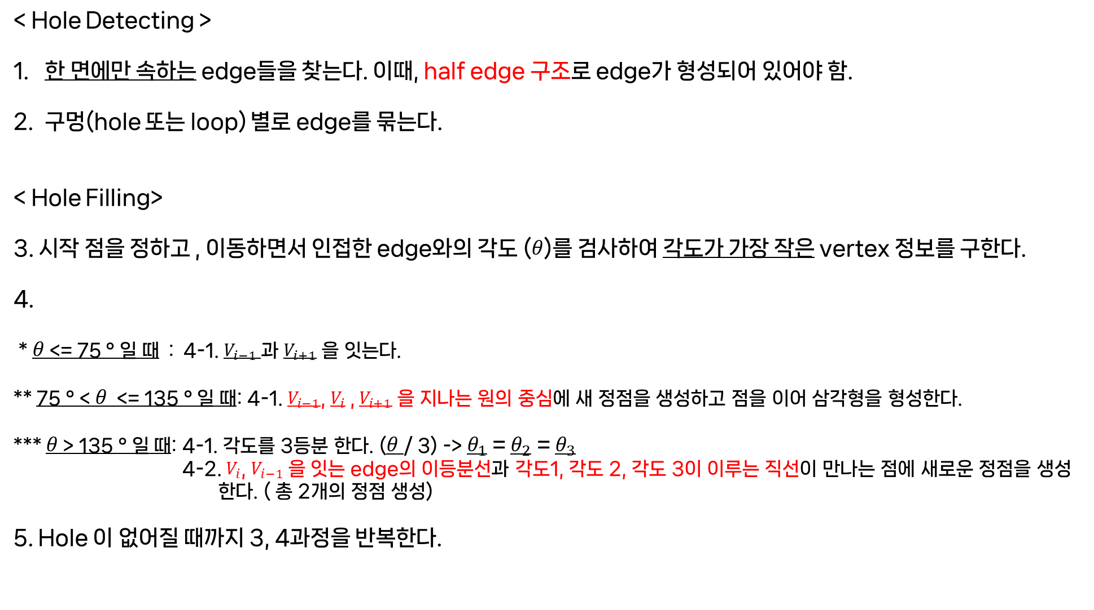
< Hole Detecting >
한 면에만 속하는 edge들을 찾는다. 이때, half edge 구조로 edge가 형성되어 있어야 함.
구멍(hole 또는 loop) 별로 edge를 묶는다.
< Hole Filling>
3. 시작 점을 정하고 , 이동하면서 인접한 edge와의 각도 ($θ$)를 검사하여 각도가 가장 작은 vertex 정보를 구한다.
4.
* $θ$ <= 75 ° 일 때 : 4-1. $V_{i−1}$과 $V_{i+1}$ 을 잇는다.
** 75 ° < $θ$ <= 135 ° 일 때: 4-1. $V_{i−1}$, $V_{i}$ , $V_{i+1}$ 을 지나는 원의 중심에 새 정점을 생성하고 점을 이어 삼각형을 형성한다.
*** $θ$ > 135 ° 일 때: 4-1. 각도를 3등분 한다. ($θ$/ 3) -> $θ_{1}$ = $θ_{2}$ = $θ_{3}$
4-2. $V_{i}$, $V_{i−1}$을 잇는 edge의 이등분선과 각도1, 각도 2, 각도 3이 이루는 직선이 만나는 점에 새로운 정점을 생성
한다. ( 총 2개의 정점 생성)
5. Hole 이 없어질 때까지 3, 4과정을 반복한다.

Slide 28

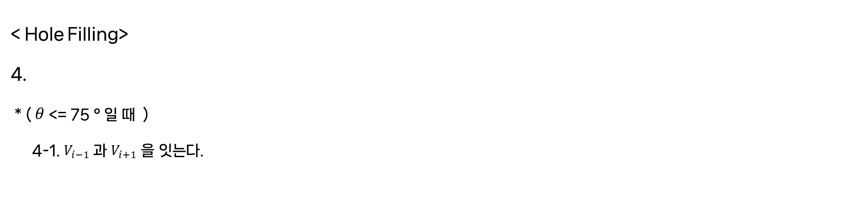



< Hole Filling>
4.
* ($θ$ <= 75 ° 일 때 )
4-1. $V_{i−1}$과 $V_{i+1}$ 을 잇는다.
$$V_{i+1}$$
$$V_{i−1}$$
$$θ≤75°$$
$$V_{i}$$

Slide 29


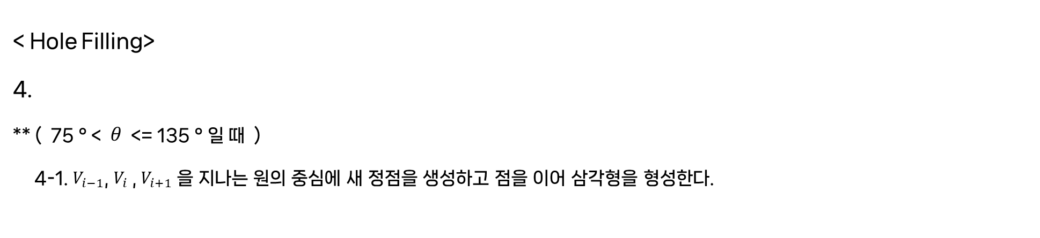



< Hole Filling>
4.
** ( 75 ° < $θ$ <= 135 ° 일 때 )
4-1. $V_{i−1}$, $V_{i}$ , $V_{i+1}$ 을 지나는 원의 중심에 새 정점을 생성하고 점을 이어 삼각형을 형성한다.
$$V_{new}$$
$$V_{i−1}$$
$$V_{i+1}$$
$$75°<θ≤135°$$
$$V_{i}$$

Slide 30



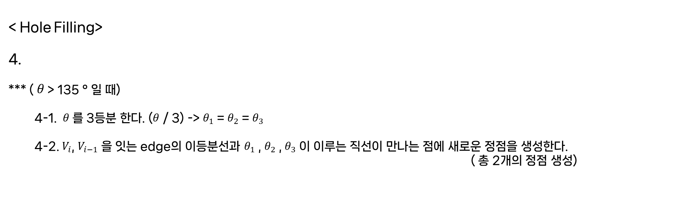






< Hole Filling>
4.
*** ($θ$ > 135 ° 일 때)
4-1. $θ$를 3등분 한다. ($θ$ / 3) -> $θ_{1}$ = $θ_{2}$ = $θ_{3}$
4-2. $V_{i}$, $V_{i−1}$을 잇는 edge의 이등분선과 $θ_{1}$ , $θ_{2}$ , $θ_{3}$ 이 이루는 직선이 만나는 점에 새로운 정점을 생성한다.
( 총 2개의 정점 생성)
$$V_{new2}$$
$$V_{new1}$$
$$V_{i+1}$$
$θ_{3}$
$θ_{2}$
$θ_{1}$
$$135°<θ$$
$$V_{i−1}$$
$$V_{i}$$

Slide 31
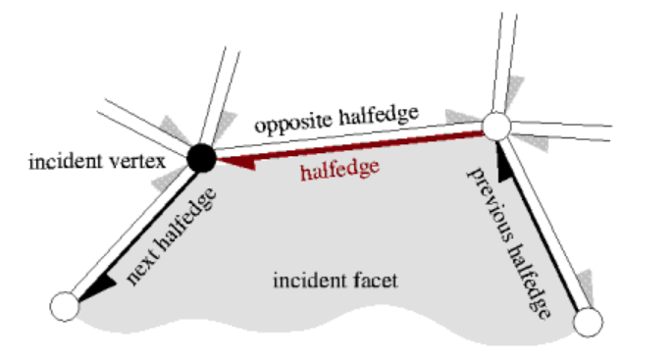
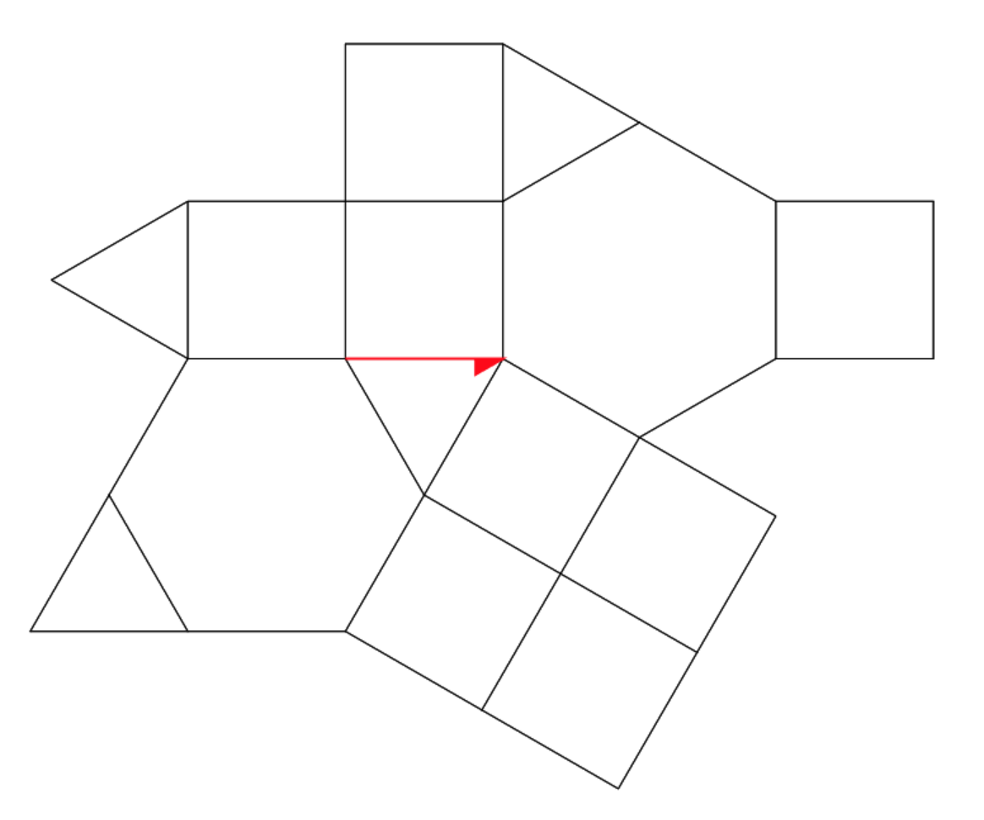
Half-Edge Data Structure
i : half-edge index
v : 해당 vertex
f : half-edge 영역의 face
next : next index
prev : prev index
twin : twin index

Slide 32
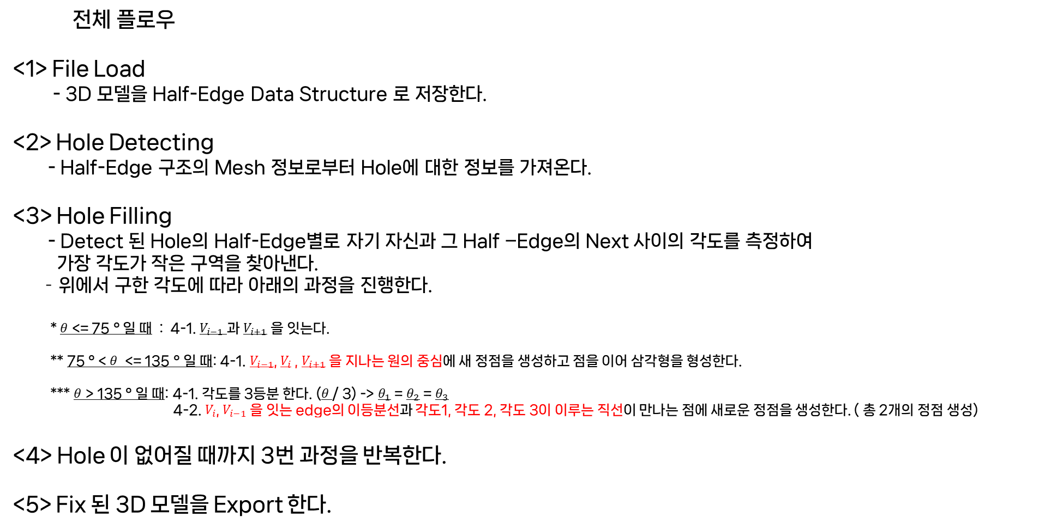
전체 플로우
<1> File Load
- 3D 모델을 Half-Edge Data Structure 로 저장한다.
<2> Hole Detecting
- Half-Edge 구조의 Mesh 정보로부터 Hole에 대한 정보를 가져온다.
<3> Hole Filling
- Detect 된 Hole의 Half-Edge별로 자기 자신과 그 Half –Edge의 Next 사이의 각도를 측정하여
가장 각도가 작은 구역을 찾아낸다.
- 위에서 구한 각도에 따라 아래의 과정을 진행한다.
* $θ$ <= 75 ° 일 때 : 4-1. $V_{i−1}$과 $V_{i+1}$ 을 잇는다.
** 75 ° < $θ$ <= 135 ° 일 때: 4-1. $V_{i−1}$, $V_{i}$ , $V_{i+1}$ 을 지나는 원의 중심에 새 정점을 생성하고 점을 이어 삼각형을 형성한다.
*** $θ$ > 135 ° 일 때: 4-1. 각도를 3등분 한다. ($θ$/ 3) -> $θ_{1}$ = $θ_{2}$ = $θ_{3}$
4-2. $V_{i}$, $V_{i−1}$을 잇는 edge의 이등분선과 각도1, 각도 2, 각도 3이 이루는 직선이 만나는 점에 새로운 정점을 생성한다. ( 총 2개의 정점 생성)
<4> Hole 이 없어질 때까지 3번 과정을 반복한다.
<5> Fix 된 3D 모델을 Export 한다.

